Slide 1
Debugging FEM
Kaur Jaakma

Slide 2
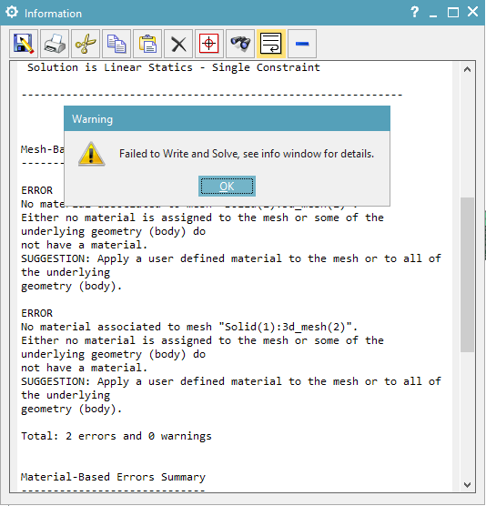
Missing Material
Mesh missing material
Error from NX
To fix:
Assign material to FEM mesh

Slide 3
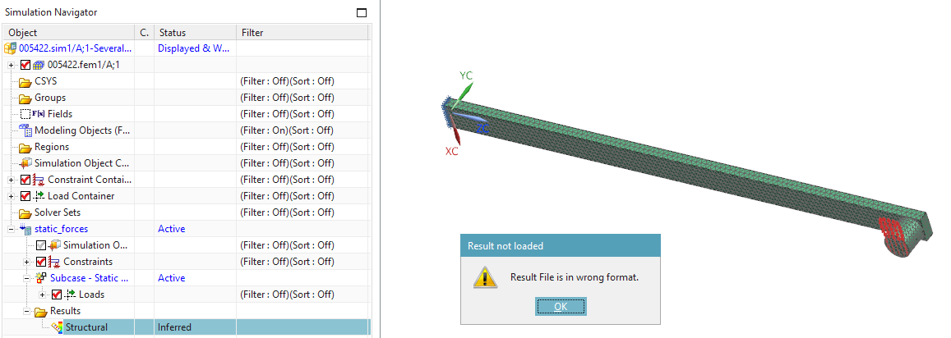
Result File in Wrong Format
Result file visible in list but “in wrong format”

Slide 4
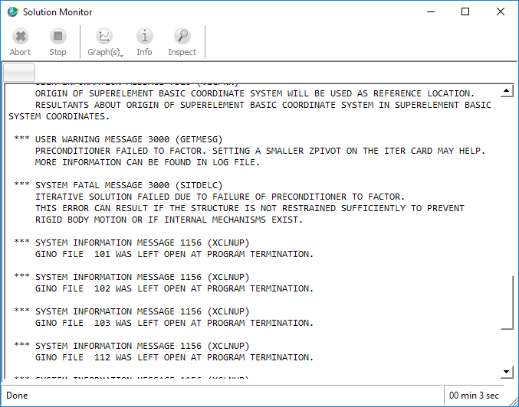
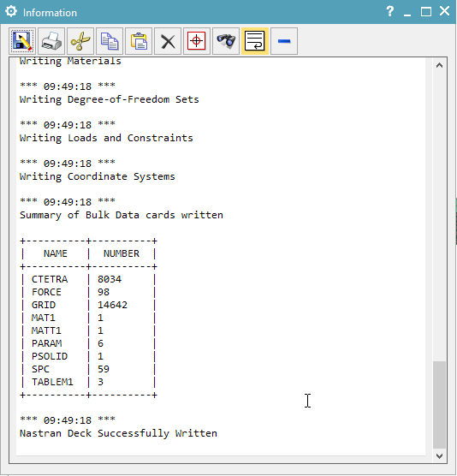
Result File in Wrong Format
Nastran deck OK, but errors on Solution Monitor

Slide 5
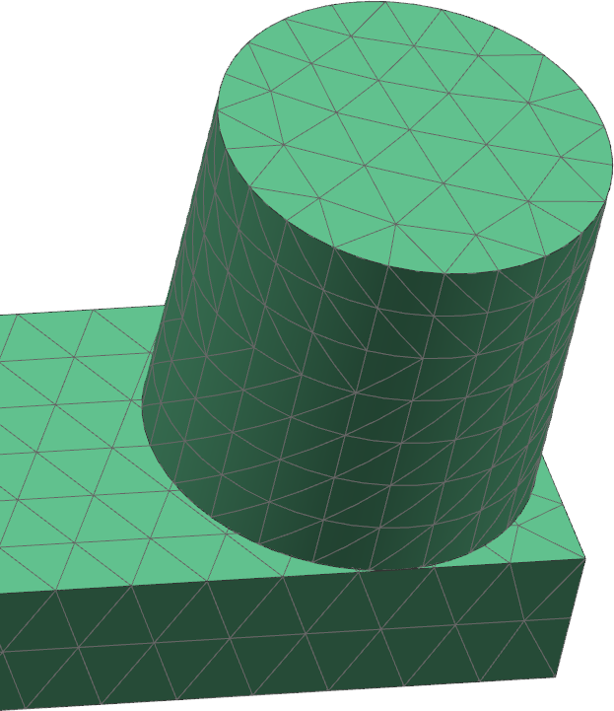
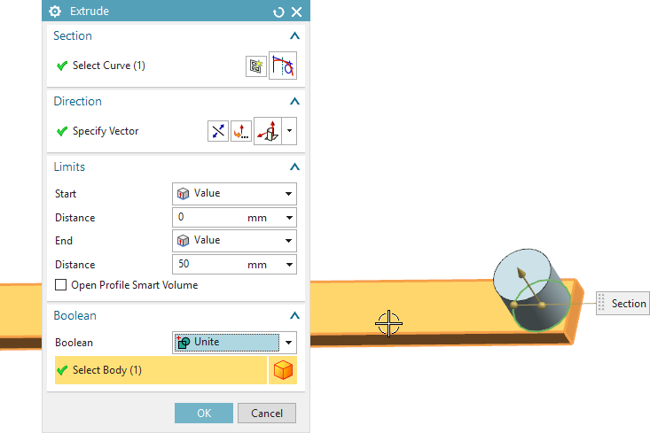
Result File in Wrong Format
Meshes not connected
NX not giving error
Nastran tells it!
To fix
Redefine NX model to have one body
Connect meshes with Mesh Mate tool

Slide 6
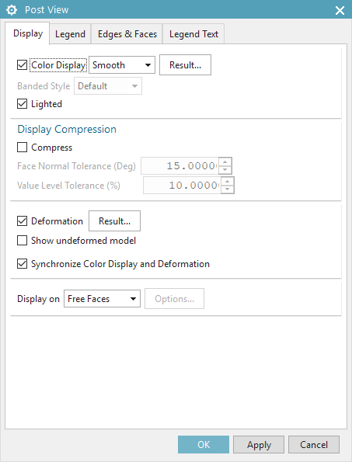
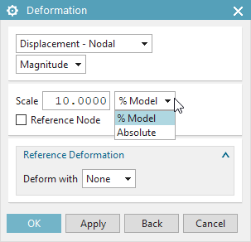
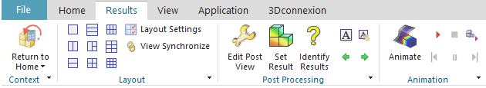
Results Screen
If geometry bends in an interesting way
Automatic scaling of the models are on
To fix
Modify Post View

Slide 7
Flexible Multi-Body Analyzes
Bonus

Slide 8
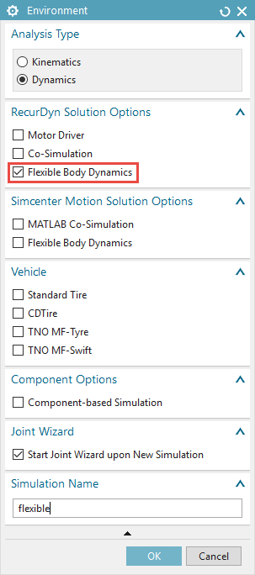
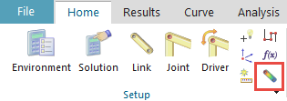
NX Environment
Flexible option must be selected beforehand
Otherwise normal MBS model
New button for flexible link

Slide 9
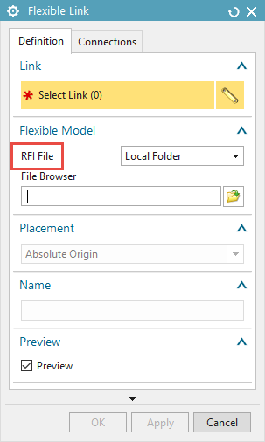
Flexible Link
Flexible link needs RFI file
Can be created in NX Nastran
Basically a FEM mesh

Slide 10
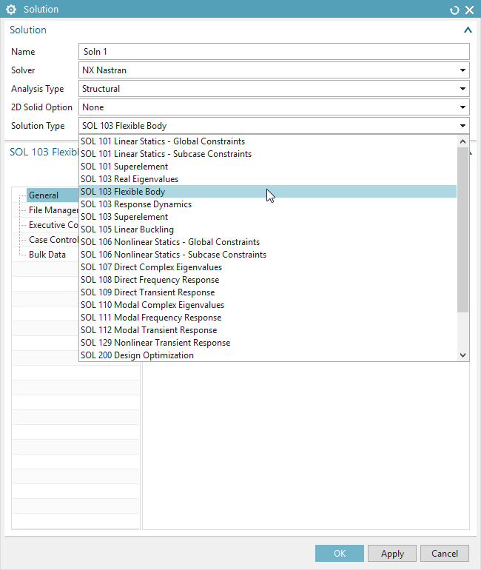
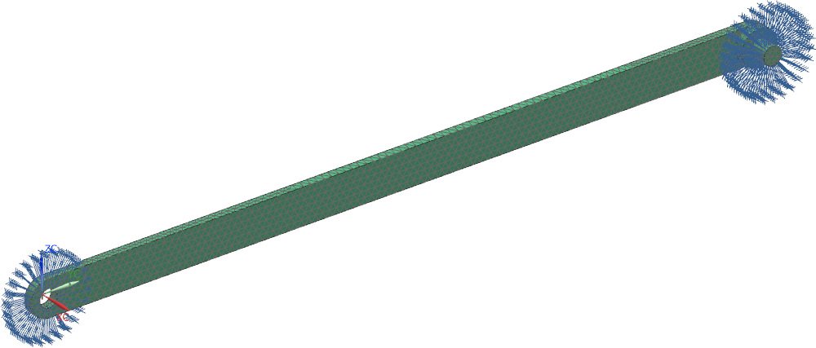
RFI File
NX Nastran solver
SOL 103 Flexible Body as Solution (modal analysis)
Material, mesh, constraints (no loads required)

Slide 11
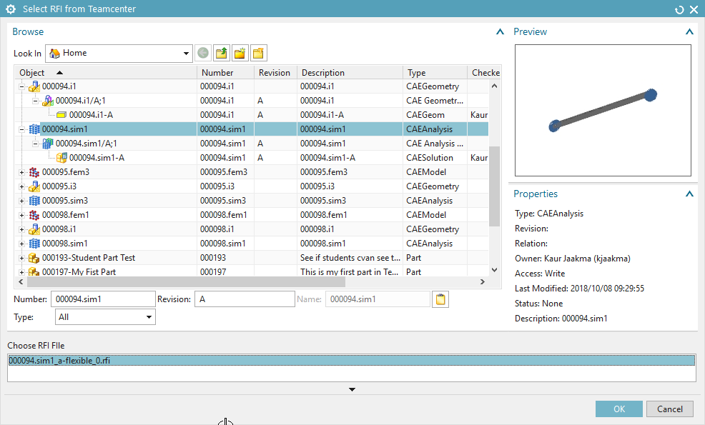
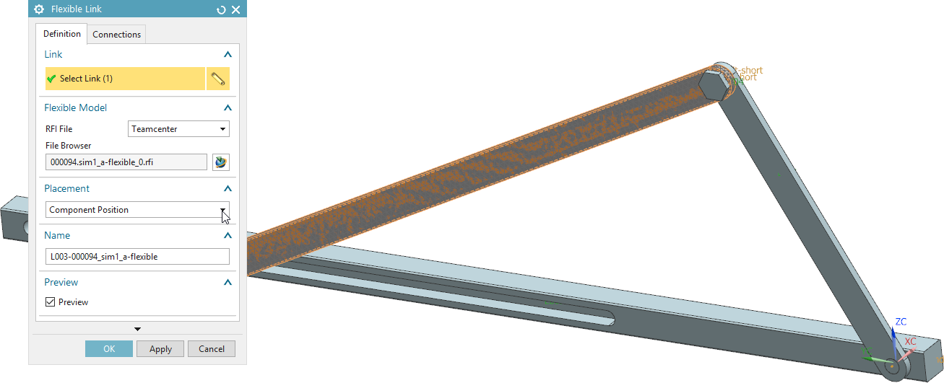
RFI File

Slide 12
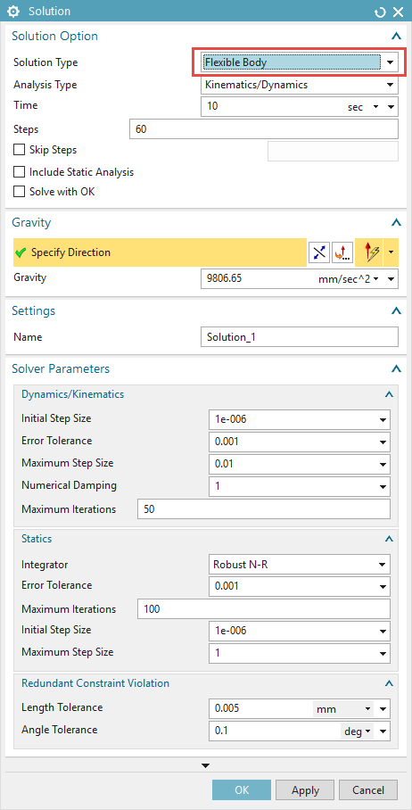
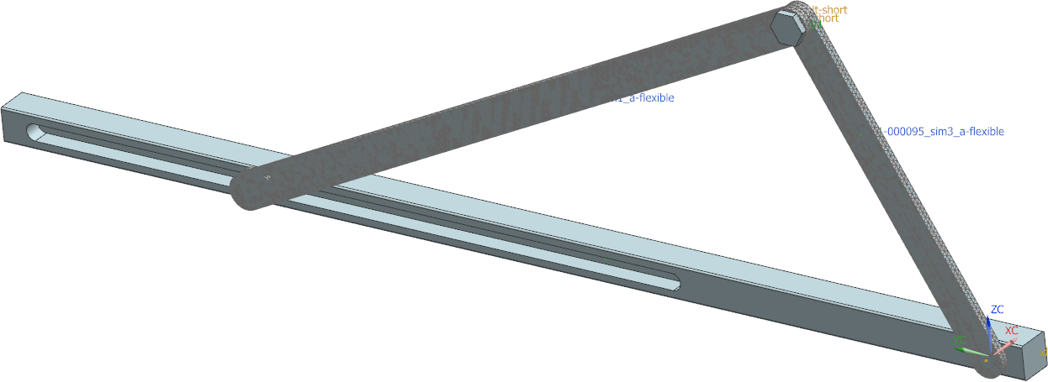
Solution

Slide 13
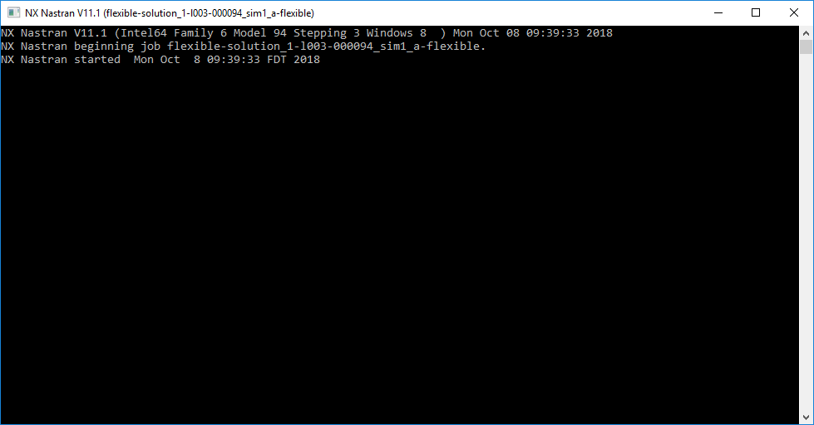
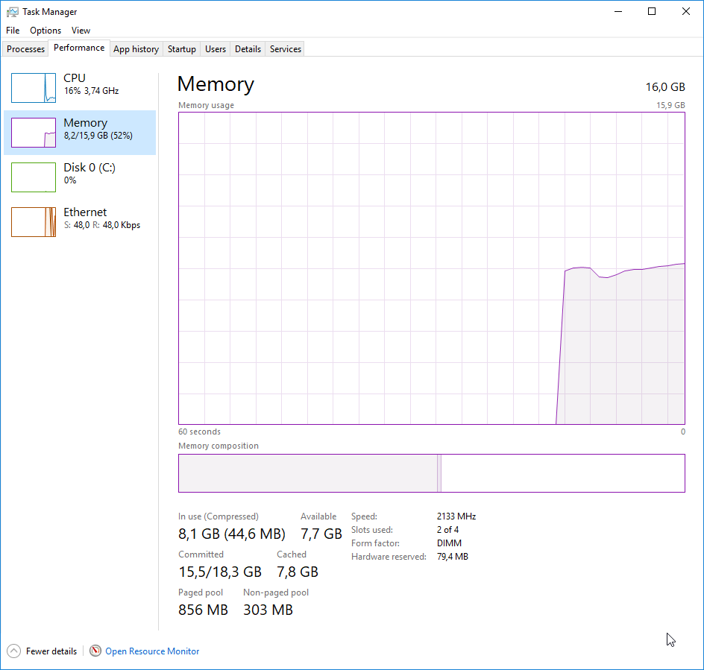
Own Solver
When all command windows are gone, simulation is ready

Slide 14
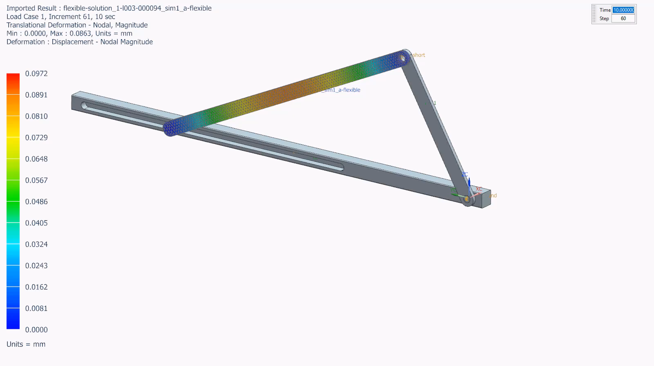
Result Movie

